Slide 1
Xiangyang Shi
October.4th Wednesday

Slide 2
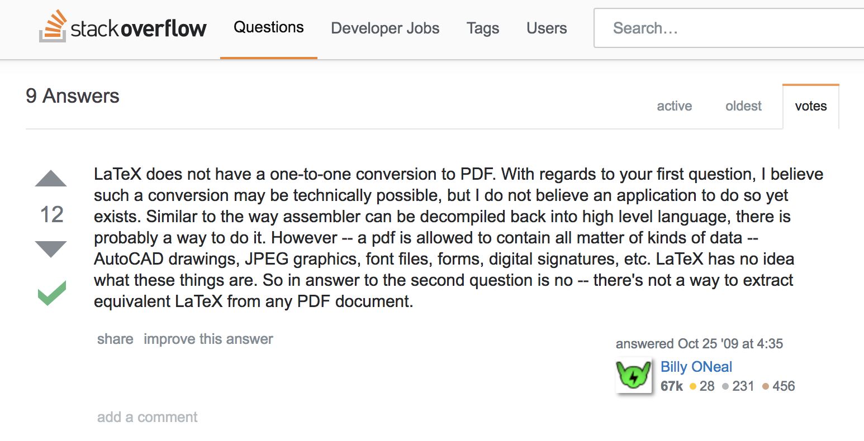
Extract Info from PDF
Decode into latex
Decode into <Html>

Slide 3



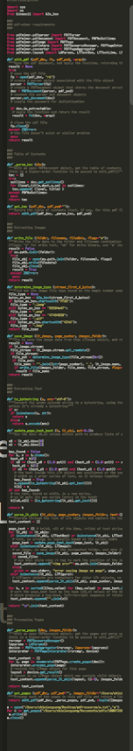
Extract info from PDF
PDF analysis
Python script
PDFminer
pyPDF

Slide 4
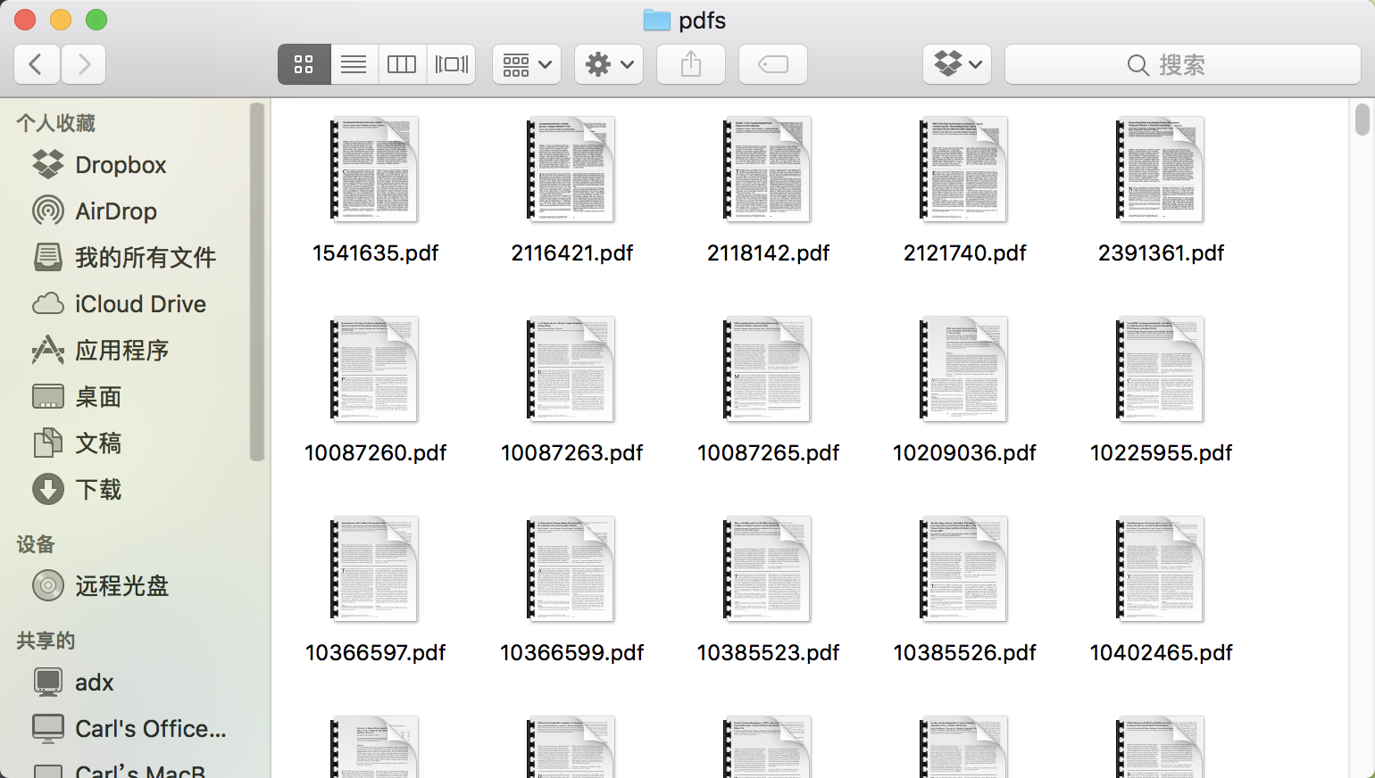
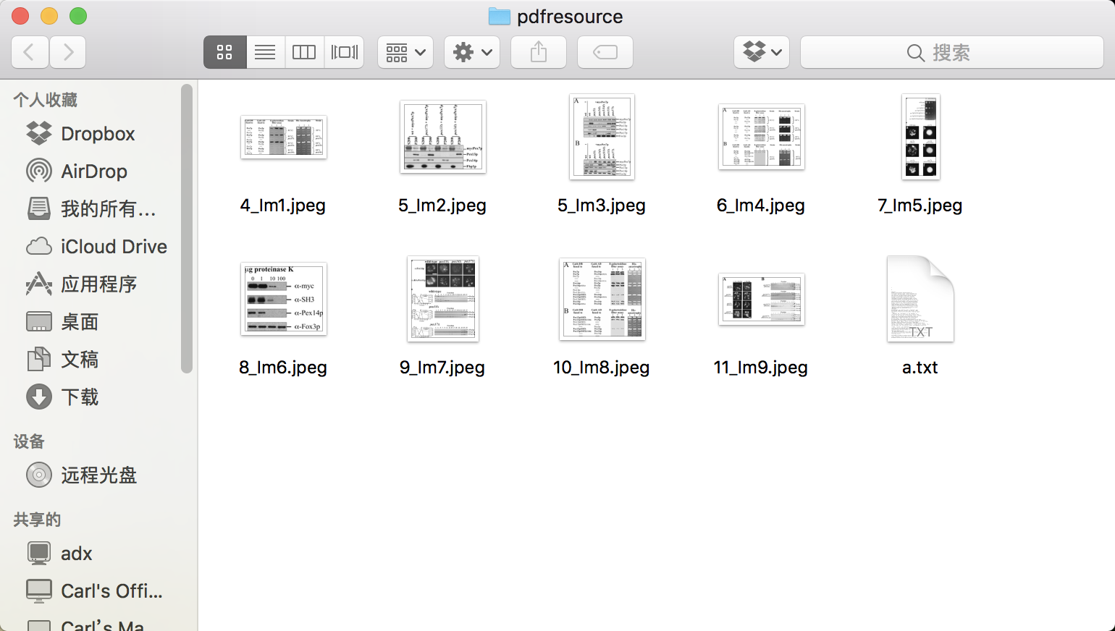
Extract info from PDF

Slide 5
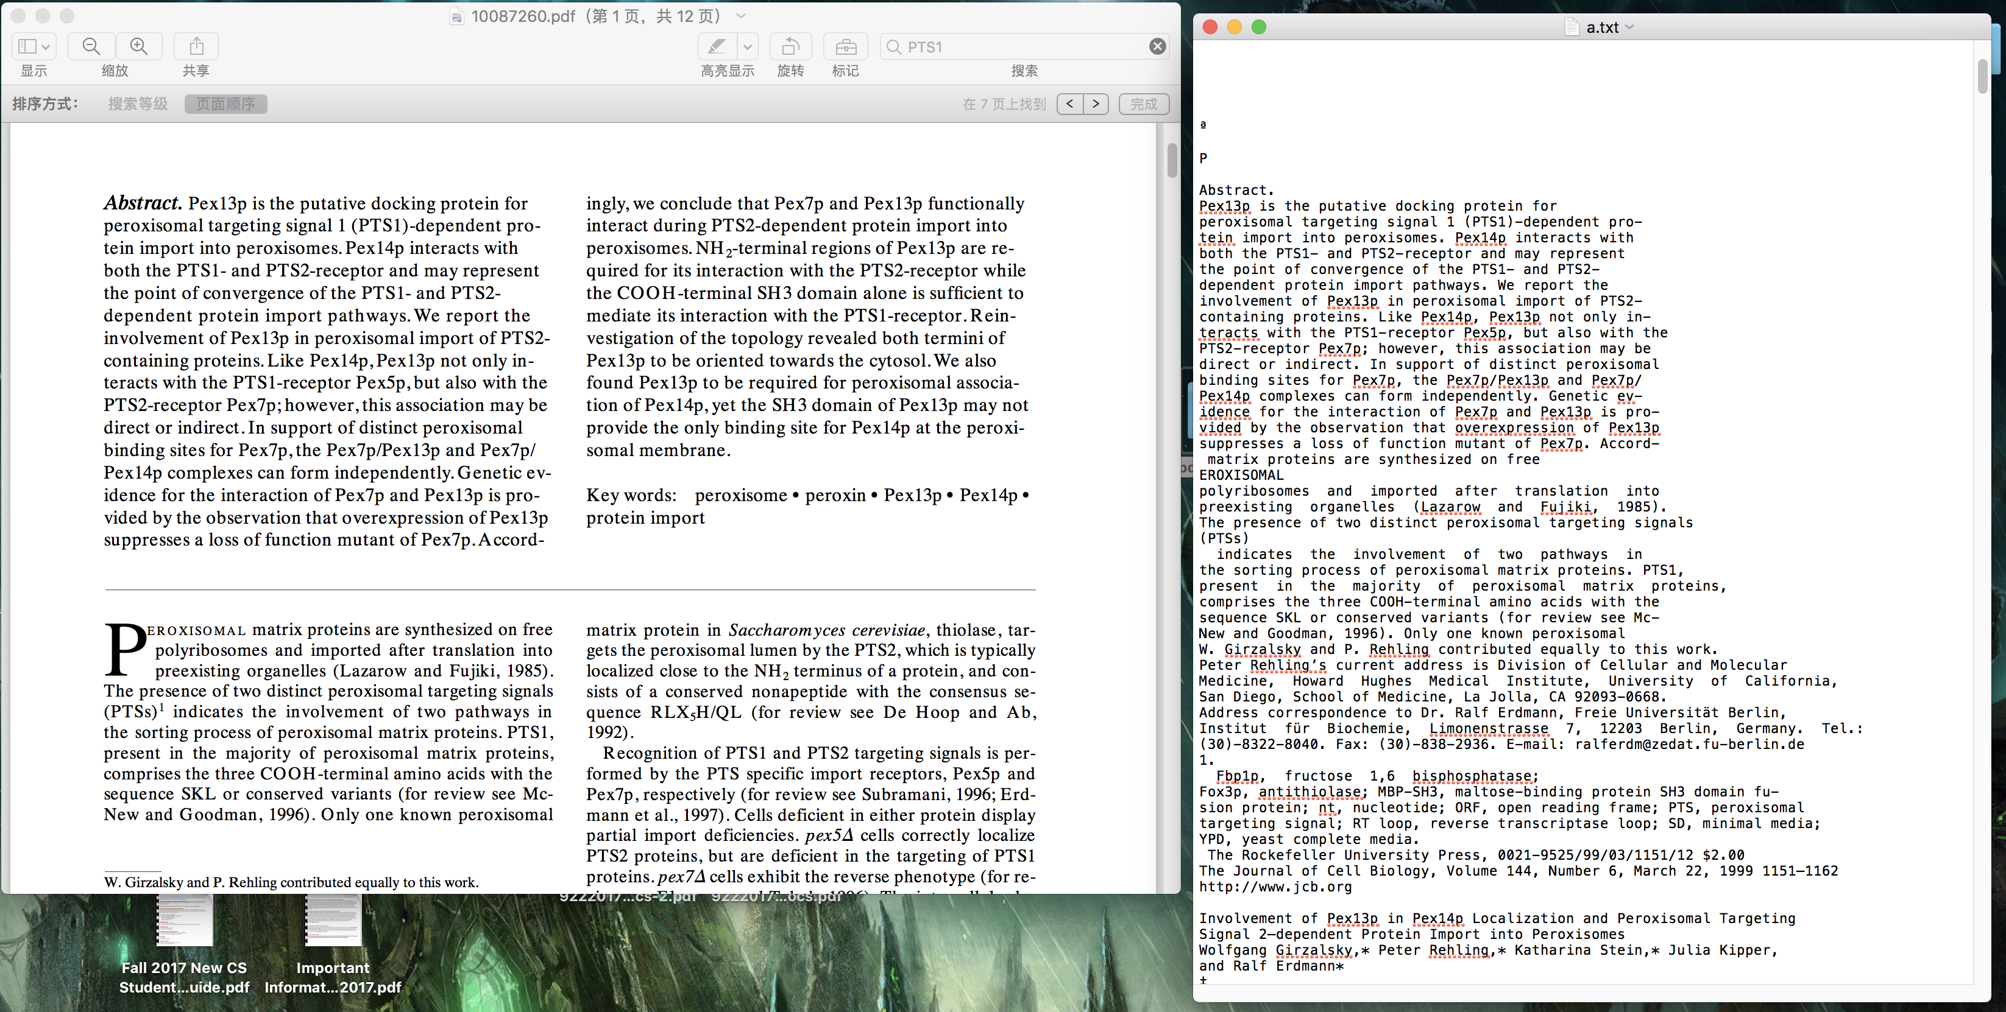
Extract info from PDF

Slide 6
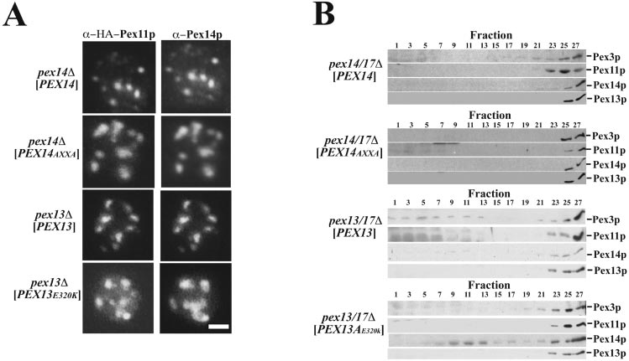
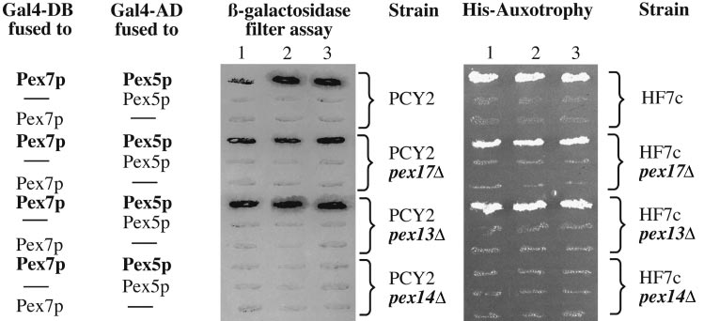
Extract info from PDF——further job
?

Slide 7
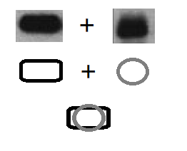
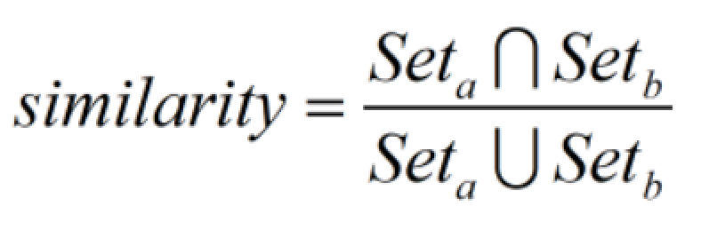
Evaluation Metric
overlap
First we get their outline
Then we move them in order to get the maximum of the similarity we define before.

Slide 8
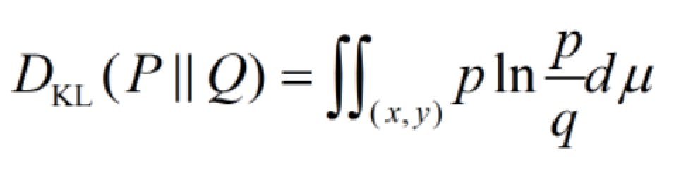
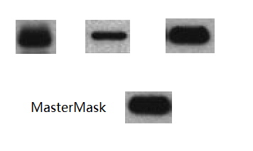
Evaluation Metric
Kullback-Leibler divergence (information gain)
Similarity=1-Dk(P||Q)
Where p&q stands for a kind of statistics probability
Here we can assume the darkness refers to the probability about how could we make shall there shall be such a protein in the position of a probe.
Its not exchangeable, which means we shall have a master mask first as a frame of reference.
First we have a float window which has the same size as Master Mask.
Then we move it to the object we want to compare.
Calculate each pixel by its average(RGB). View it as P&Q

Slide 9
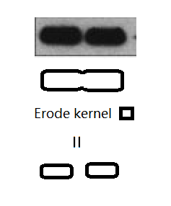
Evaluation Metric
How we can be sure there is a blot
First we can find connected component from the image.
But sometimes they two blots may overlap.
We can use Mathematical morphology erode kernel to tear them apart.
Then we use dilate to restore the origin shape.

Slide 10
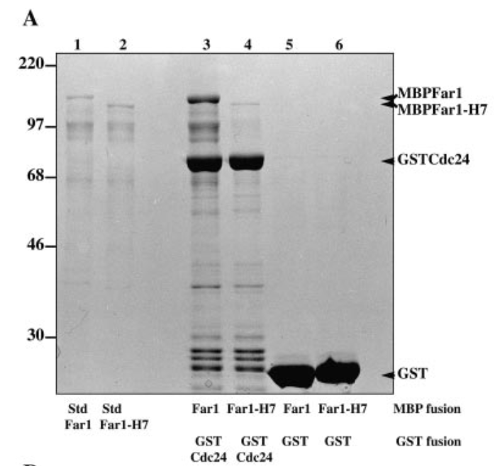
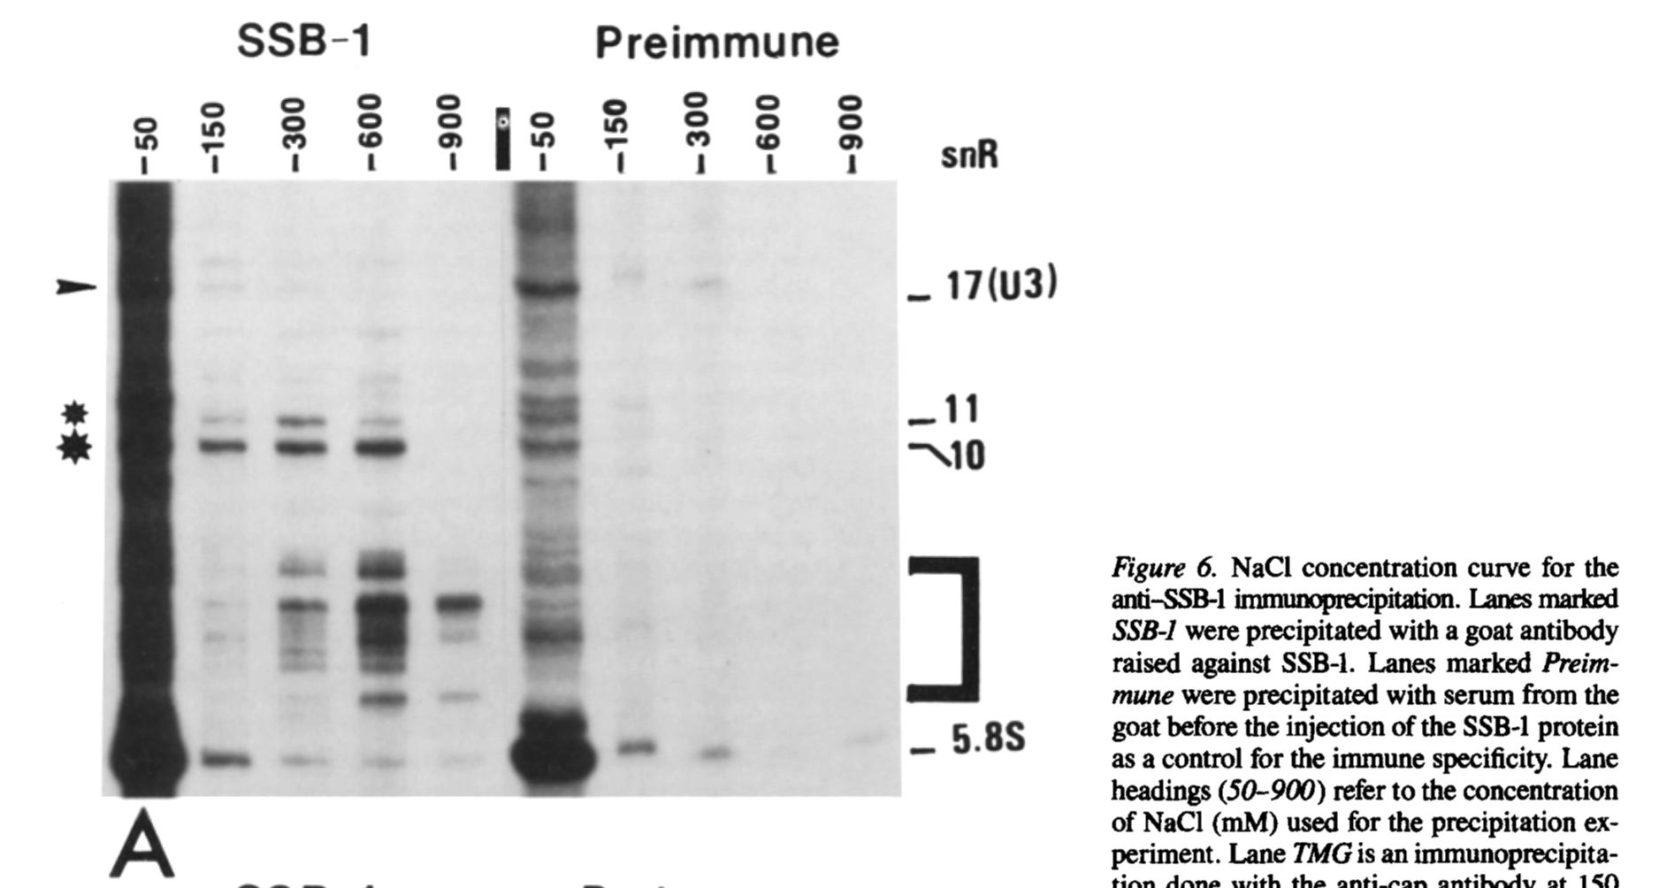
Questions: What Info shall we care from Img
We can get pharagraph which start with Figure
Notes:
What I want to dicuss here is the complexity of the problem
Because the tag of the picure sometimes is a part of the picutre that;s to say we shall analysis it
In other case they are text. So we need algorithm to find them.

Slide 11
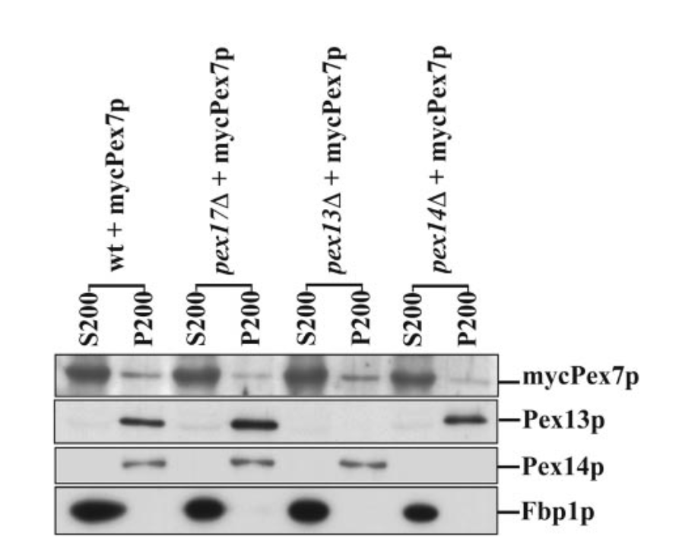
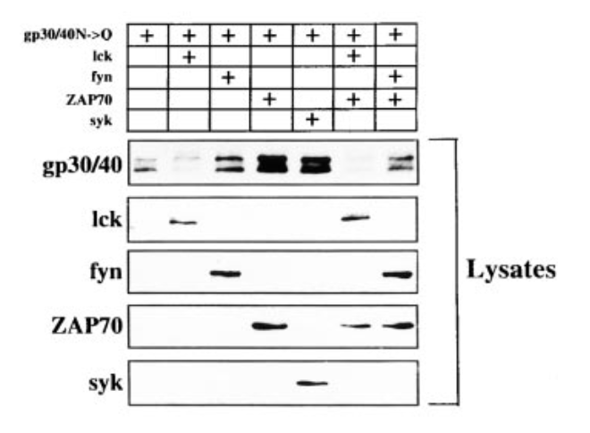
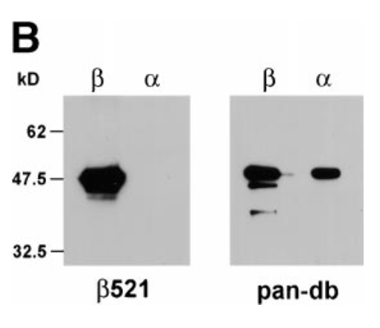
What Info shall we care from Img
Blot1
{
X=47.0;
Y=3pix;
Width=?;
Height=?;
TypeAProbability=?;
}
Link list/Dictionary
myPex7p: S200,P200,……
Pex13p: P200,……
Pex14p: P200,……
Fbp1p: S200,……
Matrix:
1 1 1 1 1 1 1
0 1 0 0 0 1 0
0 0 1 0 0 0 1
0 0 0 1 0 1 1
0 0 0 0 1 0 0
Notes:
target

